Slide 1
Weekly Update- 7/6/2017
This week’s primary focus :
Reading on pulse width and how it is measured based on the 5 width method described in the Wang Chen paper.
Researching the method used to fit all the pulsar profiles into a Gaussian fitting diagram based on Kramer’s proposed method.
Next week’s goal is to:
Begin implementation of Gaussian fitting method by potentially using Matlab code and randomly generated pulsar profiles.
Further researching components of the pulse width variables and algorithms used.
Notes:
-Pulse width is the width where there is pulse emission. However the Wpp(Width from peak to peak) only gives the distance between the two strongest peaks(it ignores the peripheral) so we need to have 5 widths calculated instead of just one. So we have the W10%, W50%...
- For the cone type(double cone peak or core-cone Triple peak)-shapes found based on polarization intensity
The Gaussian fitting method is a 3 step process:
1st-We define the on-pulse and off-pulse regions and by taking the highest peak of the pulse as the center of the first Gaussian. It’s full width at half maximum is chosen in a way that the resulting Gaussian shape represents one side of the component
2nd- Use the fit algorithms used in the paper and calculate post-fit residuals
3rd- off pulse regions and post-fit residuals are compared in the on-pulse region using the F-test in the paper pg.517
If the probability is less than the significance level, it is rejected and another largest peak value is summed
4th- repeat step 3 and 4 until all is successful
Compare these to initial estimates.

Slide 2
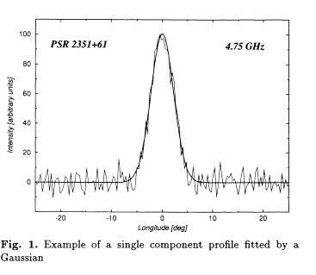

Slide 3
